Slide 1
602 Project: Potential Hazardous Asteroid Detection
Submitted By: Suhetu Ring
Presented To: Christopher McGraw

Slide 2
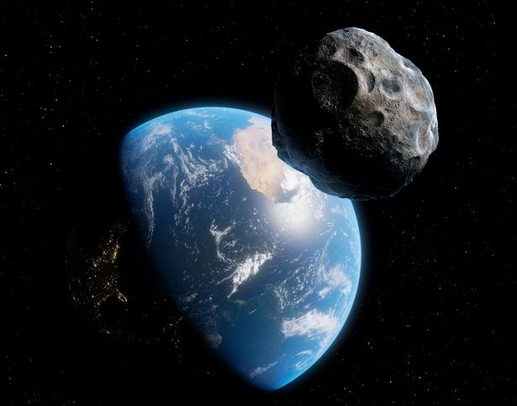
Project Motivation and Intention
Ever since my childhood the topics of space and exploration always fascinated me as a child. Based on that soft spot I had for this topic, I wanted to utilize the concepts of Machine Learning I learnt during this course to come up with something useful in this field of space exploration. Apart from that I recently saw the movie ‘Don’t Look Up’ which motivated me even further, and I came up with the perfect topic which interested me, that is classifying asteroids if they are hazardous to us or not.
This project intends to classify asteroids as potentially hazardous or not.

Slide 3
Dataset Motivation
The asteroid dataset which could be found here, https://ssd.jpl.nasa.gov/tools/sbdb_query.html#!#results is taken from the NASA JPL database. This dataset is perfect as it has immense number of observations, features and a lot of categories on the basis of which I could personalize my dataset retrieval.
The proportion of numerical and categorical features is really good and most of all, the data being from NASA would be reliable.
I really felt something useful could be built using this dataset.
However, the dataset consists of 611,239 target ‘No’ labels and just 772 target ‘Yes’ labels.

Slide 4
Contents of ML Part:
Feature Engineering
The following models were built and evaluated:
Logistic Regression
Logistic Regression with Regularization
Decision Tree
Random Forest
Support Vector Classifier
KNN
Ensemble Model

Slide 5
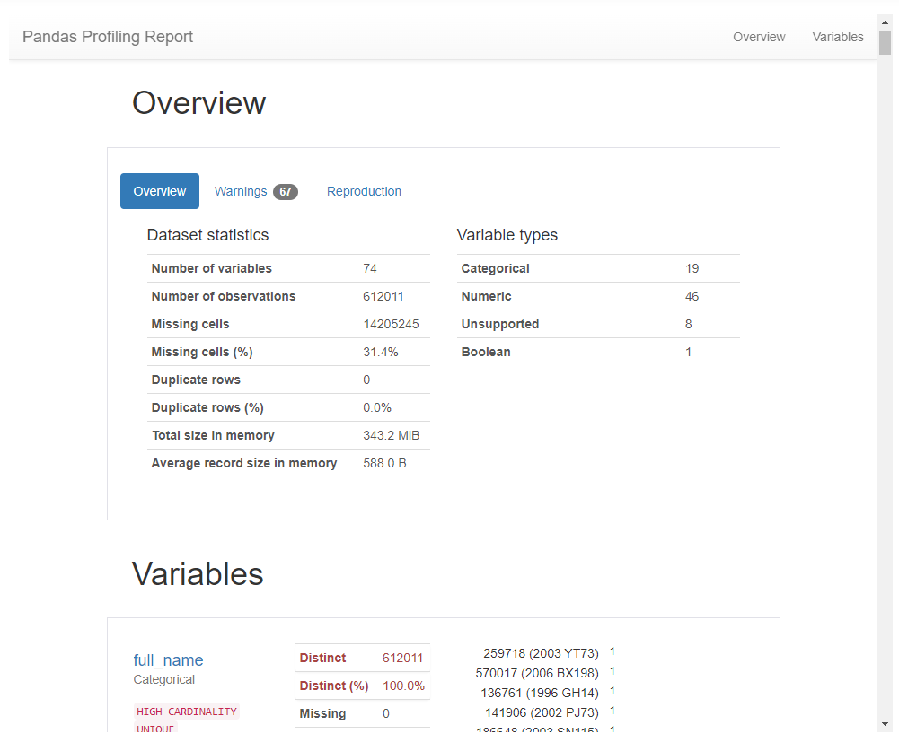
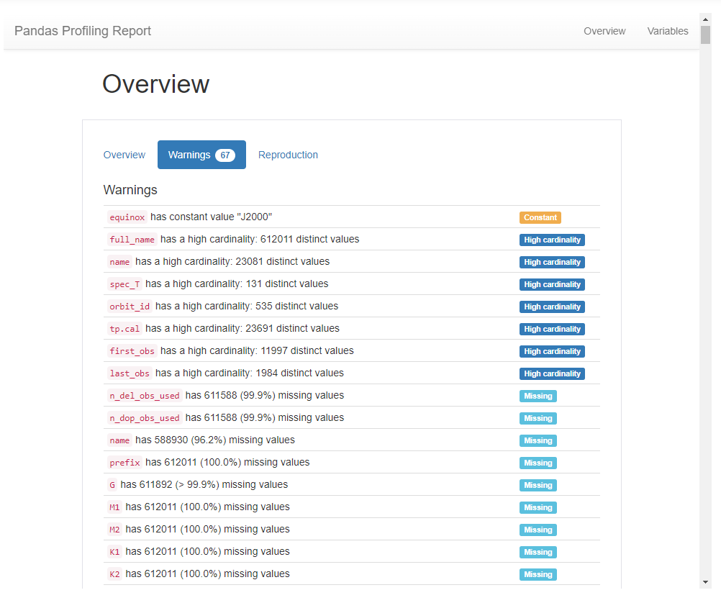
Feature Engineering
The most important aspect of feature engineering performed in this project was based on a report generated by Pandas Profiling. This library gives us a really helpful report consisting of what features will be good for building an ML model, what features may create a problem, what features are useless and so on. Features were dropped and a few features were created based on this report.

Slide 6
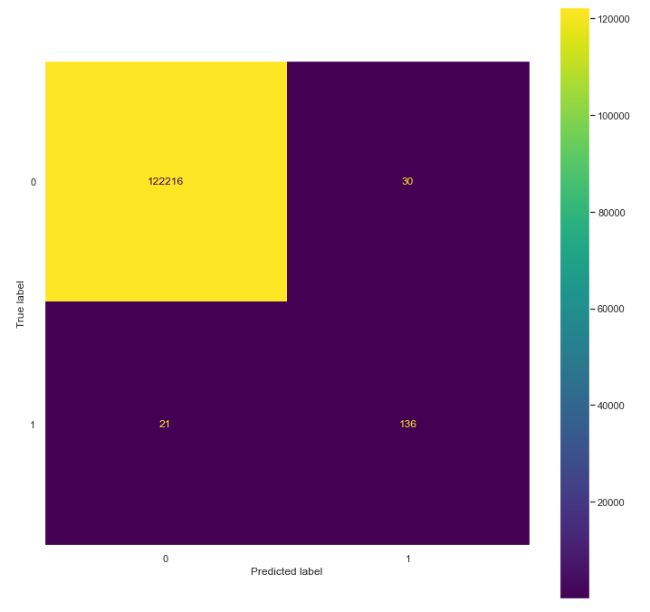
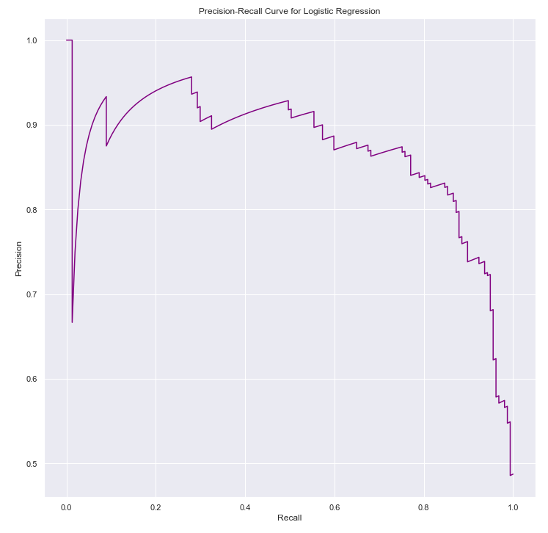
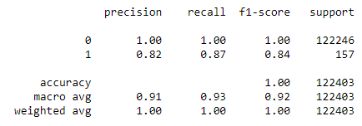
Logistic Regression
Logistic Regression gave us a really good baseline score to start working on. This model performed really well given the computation and time it consumed.
The model just took 43 seconds to train on 489,608 observations and gave us a minority class recall score of 87%.

Slide 7

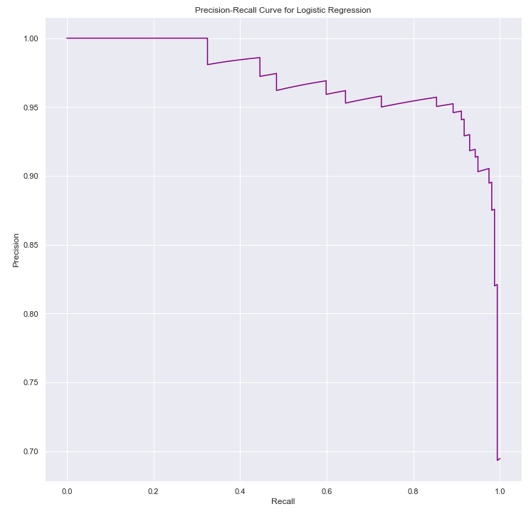
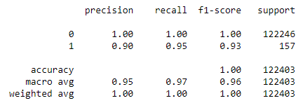
Logistic Regression with Regularization
On implementing Logistic Regression with L2 Regularization, the recall score of minority class bumped up to 95% with C=10 from 87% in normal logistic regression. So that means we are able to predict 95% of all potentially hazardous asteroids!
The model took about 18 minutes to train.

Slide 8
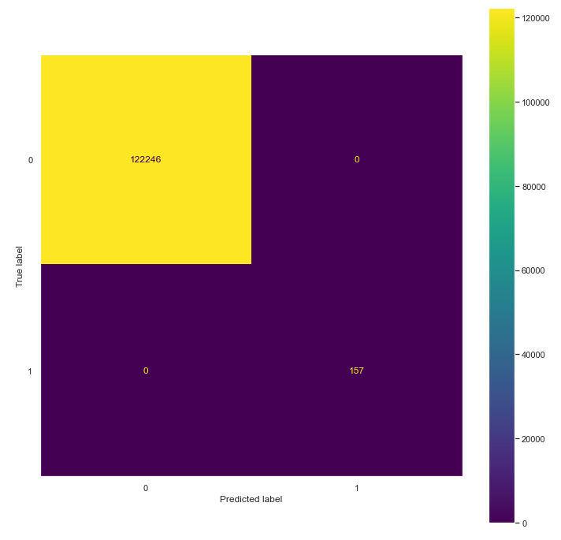
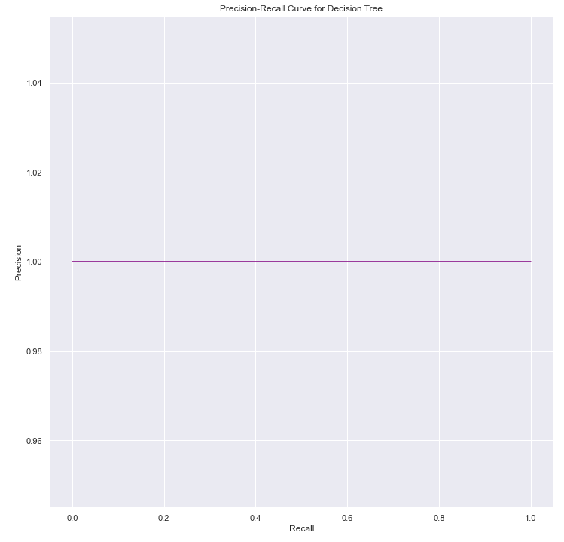
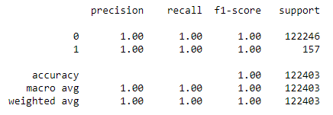
Decision Tree
The Decision Tree Classifier surprised me the most as it gave perfect (100%) precision, recall and accuracy. There were zero false positive and false negatives, and every test observation was predicted perfectly.
This model took 25 minutes to train. The hyperparameters were chosen after monitoring model performance on previous training runs.

Slide 9
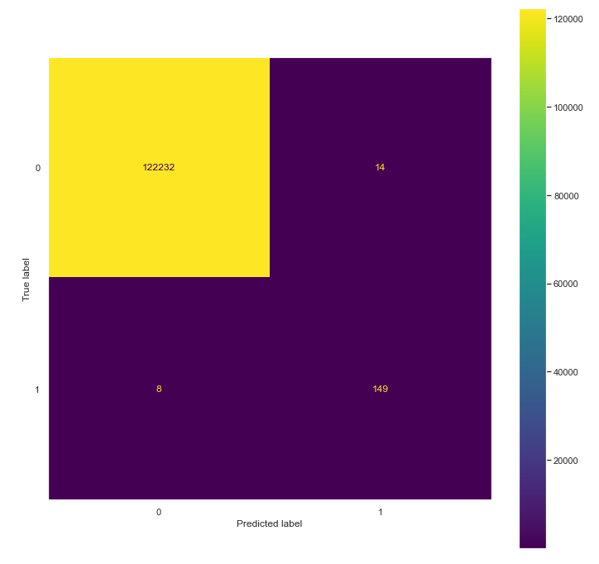
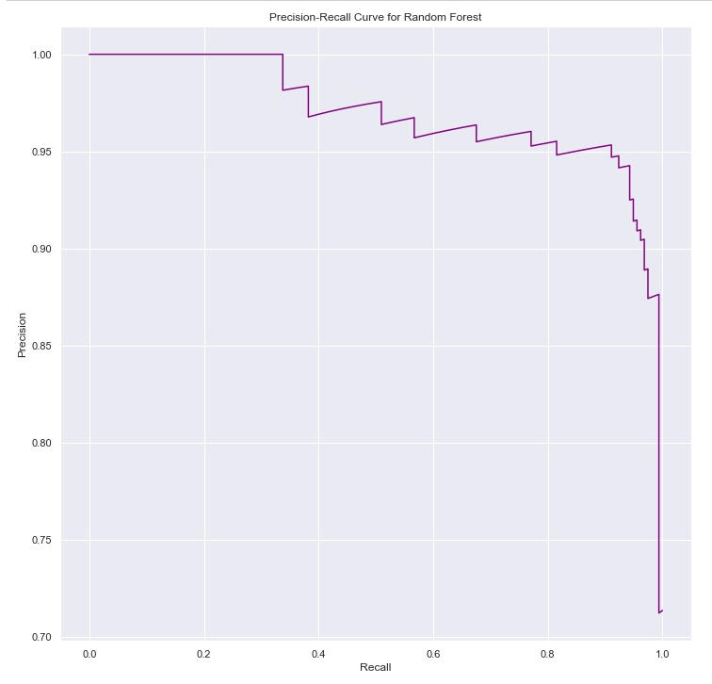
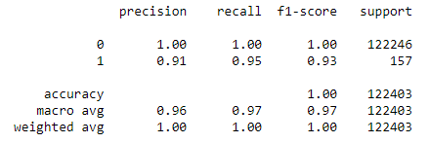
Random Forest
Random Forest classification was then implemented which gave really similar results to the Logistic Regression with L2 Regularization model. I got 95% minority class recall score and 97% macro average recall score, and the training took only 10 minutes! The hyperparameters were chosen after monitoring model performance on previous training runs.

Slide 10

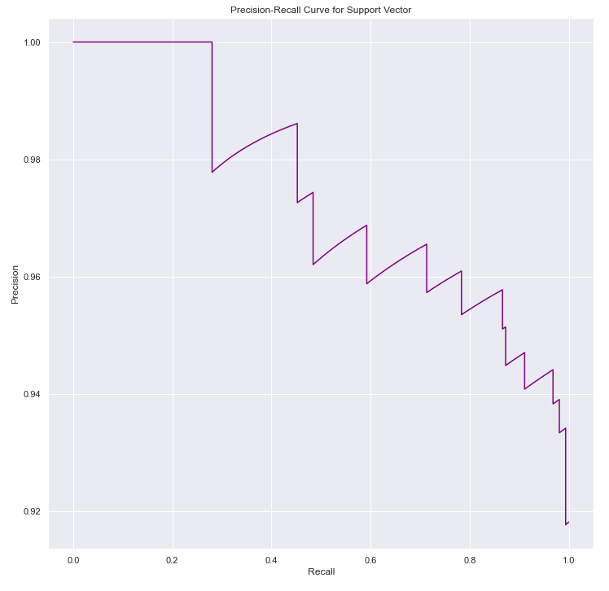
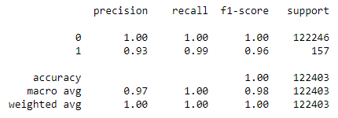
Support Vector Classifier
Support Vector Classifier also performed really well, getting a recall score of 99% for the minority class. This model also gave very few false positives and false negatives.
However, the model took 54 minutes to train. The hyperparameters were chosen after monitoring model performance on previous training runs.

Slide 11
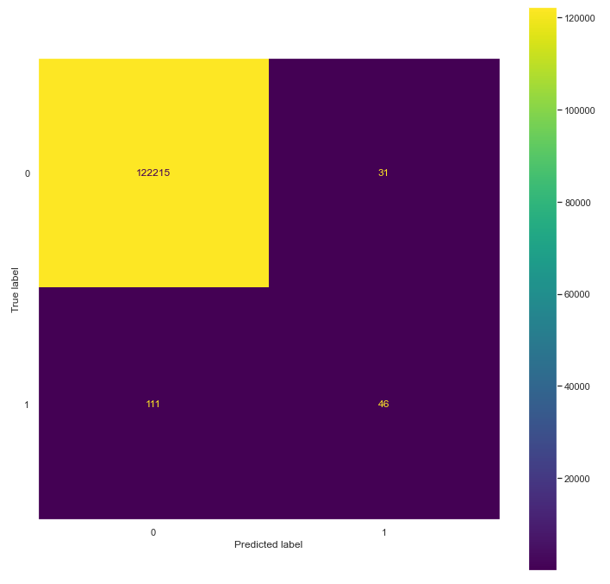
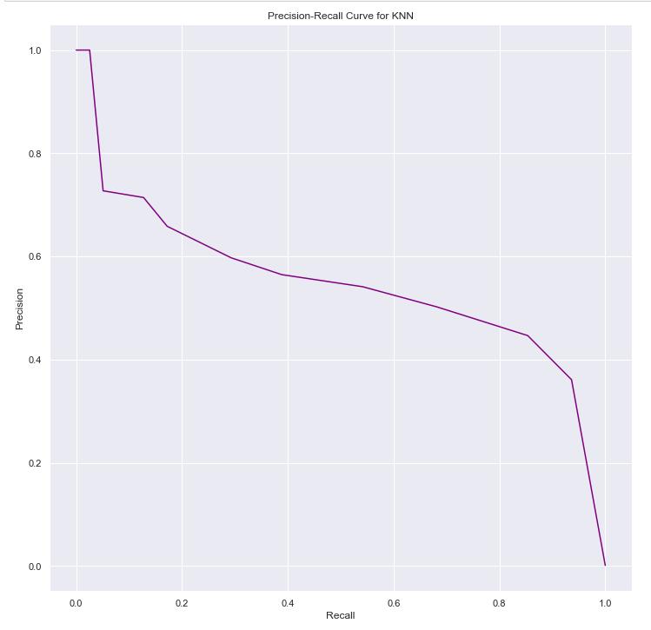
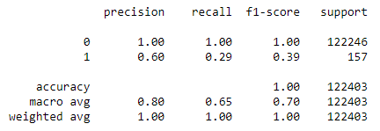
KNN
A KNN classifier was implemented after the SVC and this model surprised me the most. This model gave horrible results with recall score of 28% for the minority class. This model’s results were then ignored. This performance may be due to the nature of how this algorithm works, like it’s supposed to classify based on neighboring data points. Also, it took infinite amount of time (2 hours) to train the model.

Slide 12
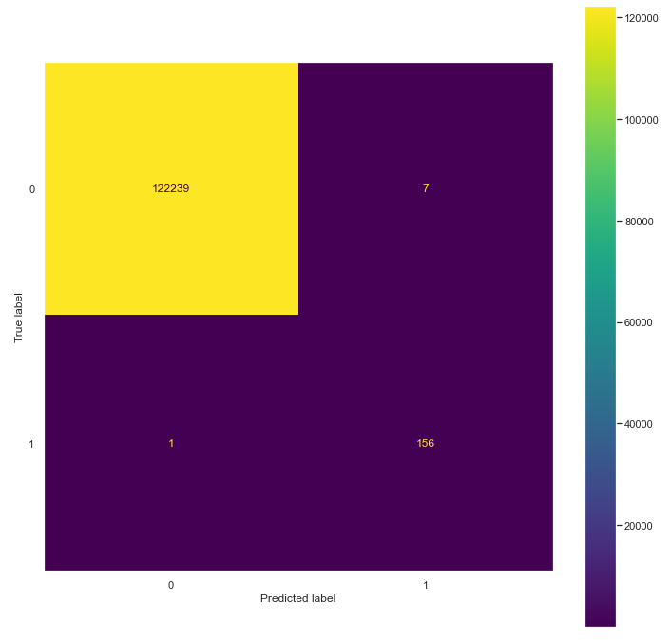
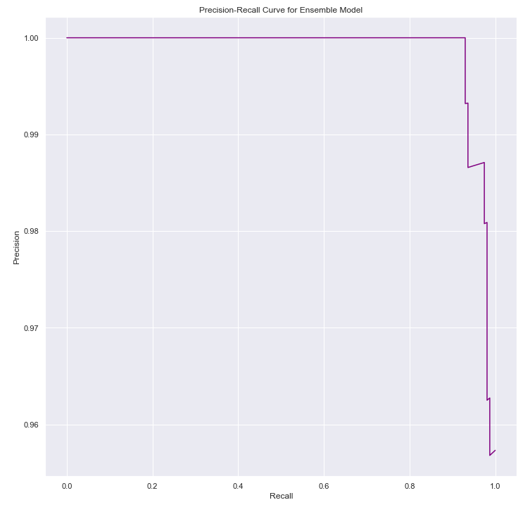
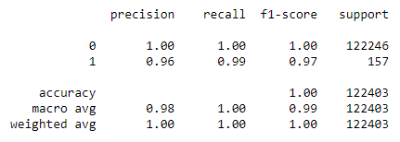
Ensemble
This ensemble consisted of Logistic Regression with Regularization, Decision Trees, Random Forest and Support Vector Classifier. This model gave 99% minority class recall score and took just 12 minutes to train.
All the hyperparameters were tuned using GridsearchCV and the best estimator models of each respective model stated above were used as ‘soft’ voters in the voting classifier algorithm.

Slide 13
Key Takeaways and Future Recommendations:
Our data was highly imbalanced with about 99% data belonging to class 0 and less than 1% data belonging to class 1. That's why we focused on the recall score to measure our model performance.
Models which performed really well were Logistic Regression with regularization, Decision Tree, Random Forest, Support Vector Classifier and the ensemble built consisting of above models.
Decision Trees model strangely gave 100% recall score, to which I'm more scared of rather happy. I'm glad the model was capable of predicting the asteroid class perfectly as the classification problem is a high risk one.
In our problem case, it is extremely important that we are able to predict True Positives and False Negatives to the best of our abilities as the problem is high risk and very costly. Hence, we might be comfortable with a few false positives but not a lot as it could still cost us.
Machine Learning is a very powerful tool.
The only recommendation and future scope I have for this project is that the pickle objects of models trained available in my GitHub repo be utilized and further trained to capture more details like possible path of asteroid.

Slide 14
Conclusion
My first choice of model for this particular classification task at hand would be the Decision Tree but a really close and almost tie would be the ensemble model because both these models give really good recall scores for class ‘Yes’. Also, ensemble classifier has the perfect balance between precision and recall as we can observe by looking at the precision-recall curve.
The best model according to the performance measured in terms of recall, was the Decision Tree classifier. This model gave amazing results while at the same time not consuming much time compared to SVC and KNN.

